Slide 1

Session 5: MODBUS
Tommy Morris
Professor, Electrical and Computer Engineering
Director, Center for Cybersecurity Research and Education
University of Alabama in Huntsville

Slide 2
PLCs are SERVERS
MODBUS PLC are servers.
The advertise a Modbus service on port 502 (this can be changed).
Most PLC will accept connections from any client.
Most PLC will accept multiple simultaneous connections to port 502.
Radzio is a debug tool. But why craft a new tool for injection when one already exists?

Slide 3
3 Modbus Protocols
Modbus/RTU
Serial port with binary data on the wire.
Modbus/ASCII
Serial port with ASCII data on the wire.
Modbus/TCP
TCP/IP encapsulation of the Modbus Protocol Data Unit (PDU) from Modbus/RTU.

Slide 4
MODBUS
Modicon Bus protocol was first published in 1979
Serial communication protocol
MODBUS RTU - serial port, binary data stream
MODBUS ASCII – serial port, ASCII data stream
MODBUS TCP/IP – similar to RTU encapsulated by TCP/IP
Type | Address | Function Code | Data | CRC/LRC | CR/LF
RTU | 1 byte | 1 byte | 0 – 252 bytes | 2 bytes | ---
ASCII | 2 char (2 bytes) | 2 char (2 bytes) | 0 - 504 char (0 – 504 bytes) | 2 char (2 bytes) | 2 char (2 bytes)
Notes:
ASCII uses a longitudinal redundancy check (LRC). Each ASCII packet begins with a colon (3A) and is followed by the carriage return and line feed ASCII characters (0D 0A)
The ASCII protocol uses the same values as RTU, but converted to ASCII. For example, if the address was 11 in hexadecimal (as used in RTU), it would be sent as 3131 in ASCII because the number 1 is represented by 31 in ASCII.
This may help: https://www.branah.com/ascii-converter

Slide 5
MODBUS
Function Code | Action | Name
01 (01 hex) | Read | Discrete Output Coils
05 (05 hex) | Write single | Discrete Output Coil
15 (0F hex) | Write multiple | Discrete Output Coils
02 (02 hex) | Read | Discrete Input Contacts
04 (04 hex) | Read | Analog Input Registers
03 (03 hex) | Read | Analog Output Holding Registers
06 (06 hex) | Write single | Analog Output Holding Register
16 (10 hex) | Write multiple | Analog Output Holding Registers
Addresses are assigned to each device
Range from 1 to 247 decimal (0x01 to 0xF7)
Address 00 is reserved for broadccast
Function codes tell what to access and whether to read or write
Notes:
http://www.simplymodbus.ca/FAQ.htm

Slide 6
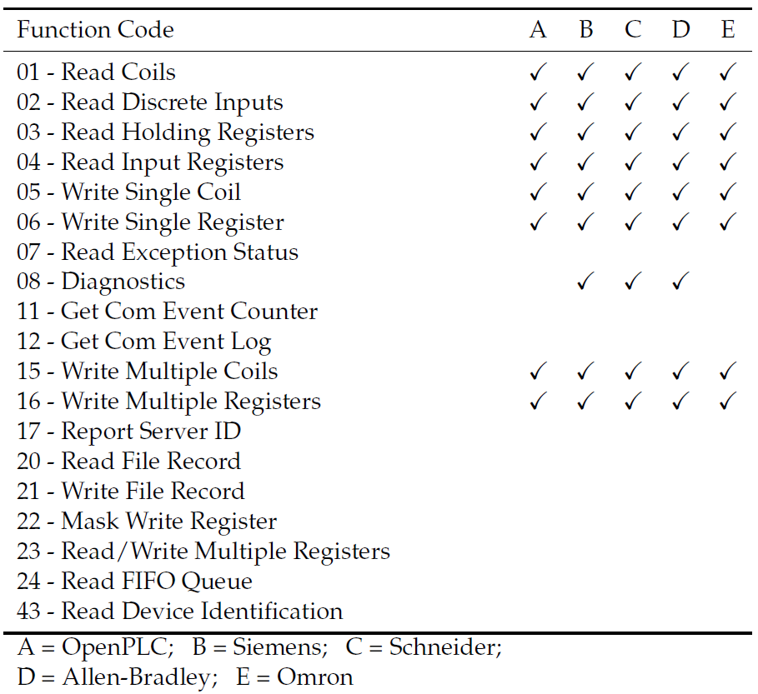
OPENPLC MODBUS Support Compared TO Commercial

Slide 7
MODBUS – RTU Example One
If the MODBUS RTU message 130400080001B37A is received, it can be broken down into address, function code, data, and CRC:
The destination is address 0x13, decimal 19
Function code 0x04 means “Read input registers”
0008 is the address of the first register requested
Decimal 8 + offset of 30001 = input register 30009
0x0001 is the number of registered requested (just one)
Address | Function Code | Data | CRC
13 | 04 | 0008 0001 | B37A

Slide 8
MODBUS – RTU Example Two
The reply will consist of the same address and function code of the request.
The data field will contain the number of bytes to follow
Each register is two bytes, so reading one register returns two bytes
Next, the register contents requested (two bytes in this case)
Another CRC
Address | Function Code | Data | CRC
13 | 04 | 02 004C | 00C6

Slide 9
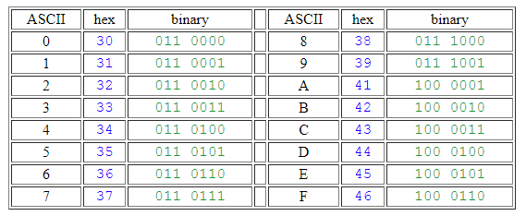
MODBUS – ASCII Example
In the RTU example, 130400080001B37A was received as a request to read the eighth register of the device at address 19 (decimal).
To send the same request in MODBUS ASCII, convert each digit into ASCII.
For example, “1” in ASCII is 31 hex and “3” in ASCII is 33 hex, so the first byte of the RTU message will be translated as 3133
Notes:
ASCII Table: http://www.simplymodbus.ca/ASCII.htm

Slide 10
MODBUS – ASCII Example Continued
Continue converting the message to ASCII
There will be twice as many bytes as in the RTU message
130400080001B37A becomes 3133 3034 3030 3038 3030 3031 4233 3741
ASCII messages begin with a colon and end with CRLF
“:” is 3A hex
CRLF is carriage return line feed, which designates a new line
CR and LF have ASCII representations that translate to 0D0A
Colon | Address | Function Code | Data | LRC | CR LF
3A | 3133 | 3034 | 3030 3038 3030 3031 | 4233 3741 | 0D0A
Notes:
LRC is

Slide 11
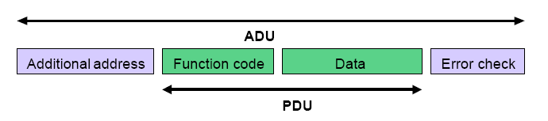
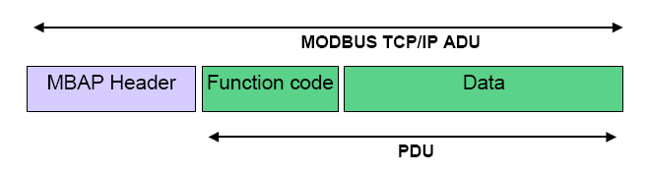
MODBUS TCP/IP
MODBUS Application Data Unit (ADU) – independent of physical layer
MODBUS Application Data Unit (ADU) – independent of physical layer

Slide 12
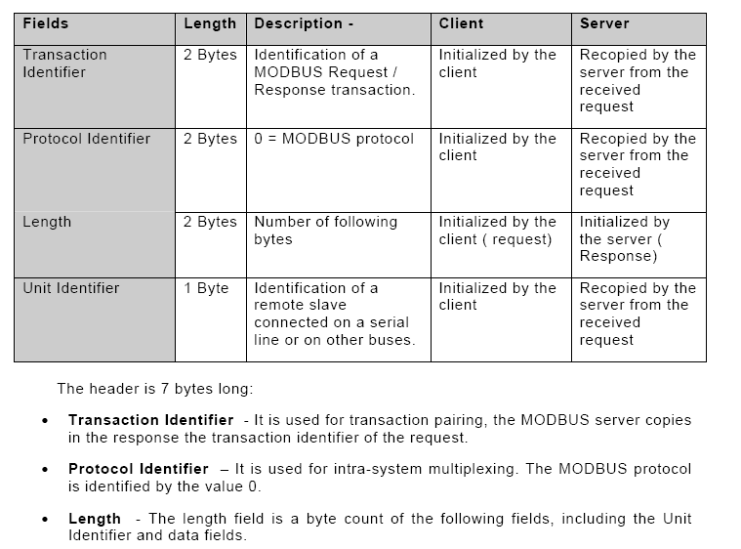
MODBUS TCP/IP

Slide 13
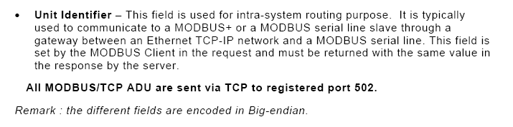
MODBUS TCP/IP
No CRC; rely on Ethernet CRC-32
MODBUS TCP/IP allows multiple simultaneous outstanding ADU
All ADU requests must be followed by an ADU response from out station.
MODBUS over Serial only 1 outstanding ADU is allowed.

Slide 14
MODBUS
Security Features
Access Control (not built in to protocol)
common to have password registers
devices require password entry before use of privileged functions.
Missing Security Features
Authentication – digital signature
No way validate ID (source) of commands and responses
Encryption
No confidentiality

Slide 15
MODBUS READ and WRITE ADDRESSES
There are two types of MODBUS address.
Device address
For RTU and ASCII modes there is a MODBUS Device address.
This address is in the header and selects a PLC for communication.
The equivalent address for MODBUS/TCP is the IP address.
Coil and Register Addresses
Within the payload of read and write commands there is an address.
The PLC exposes memory to Modbus clients.
Inputs and outputs are mapped to this space.
Variables may also be mapped to this space.
The PLC writes sensor data, stores variables, and reads config settings from this address space.
The client reads sensor data, PLC variables and state, and writes config settings rom this address space.

Slide 16
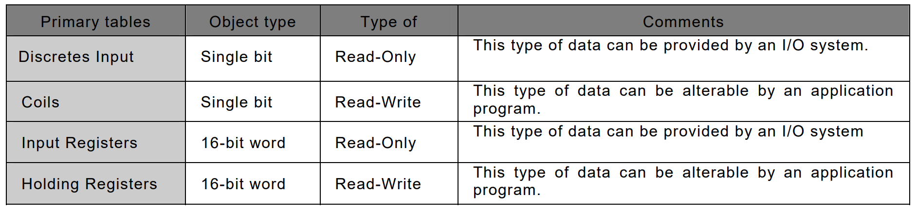
MODBUS Address SPACE
There are four memory tables corresponding to the 4 Modbus data types.
There may be four separate blocks of memory for the four types or
It is perfectly acceptable, and very common, to regard all four tables as overlaying one another, if this is the most natural interpretation on the target machine in question.

Slide 17
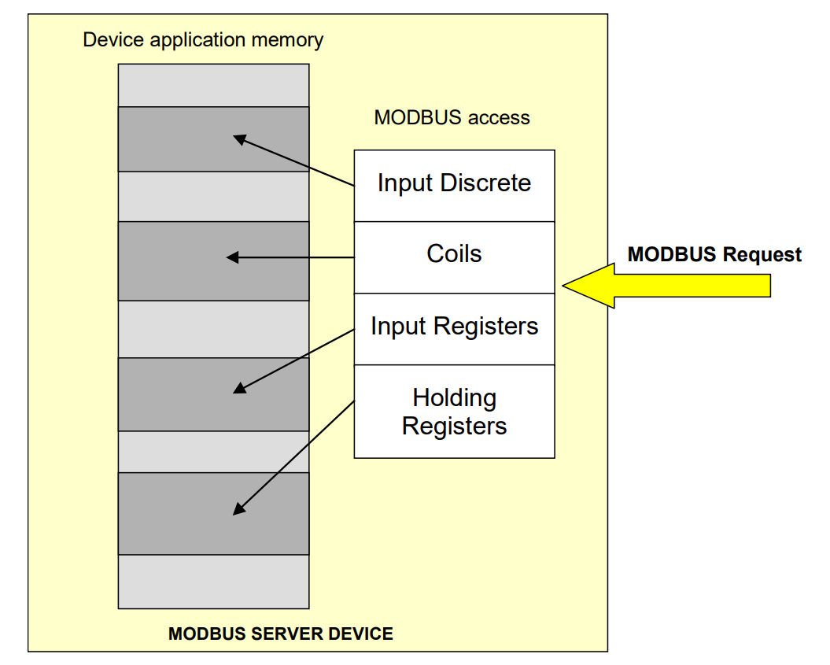
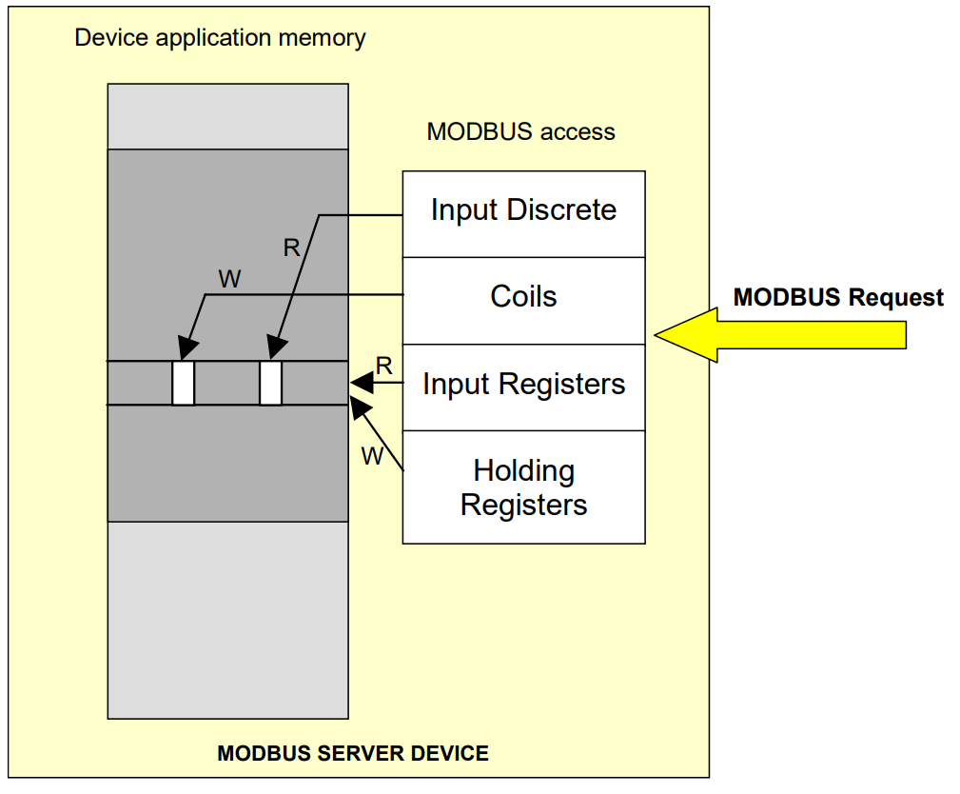
Memory Tables
Separate Blocks
Overlapping Blocks

Slide 18
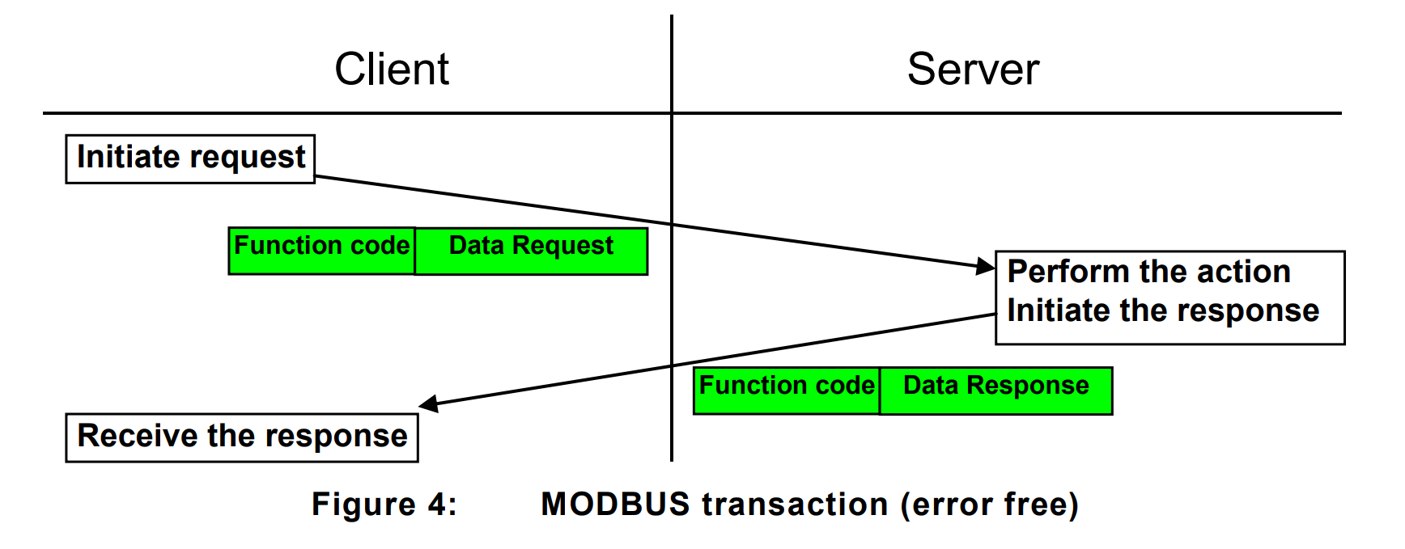
MODBUS Traffic

Slide 19
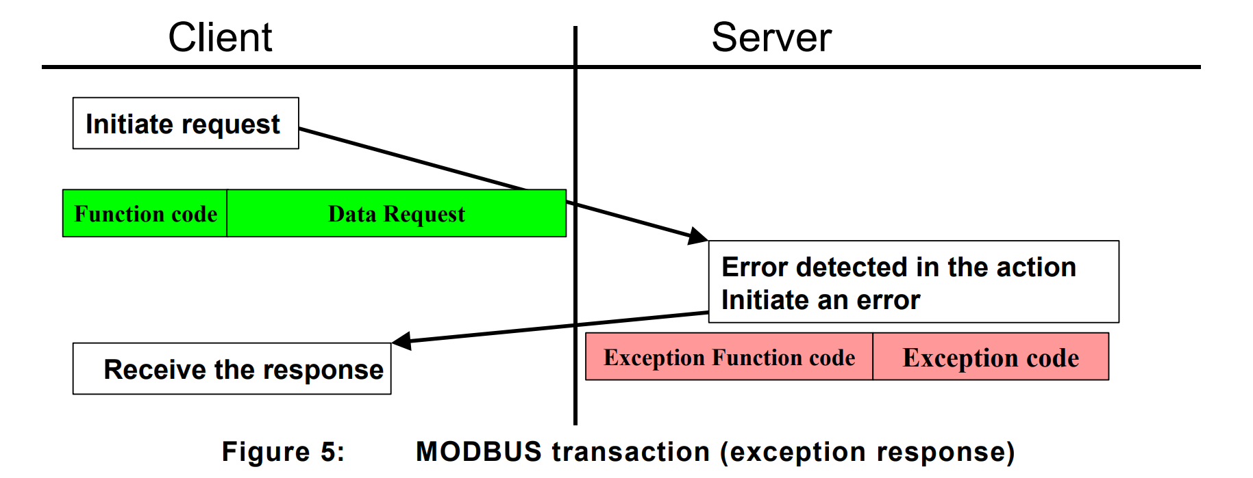
Modbus Traffic

Slide 20
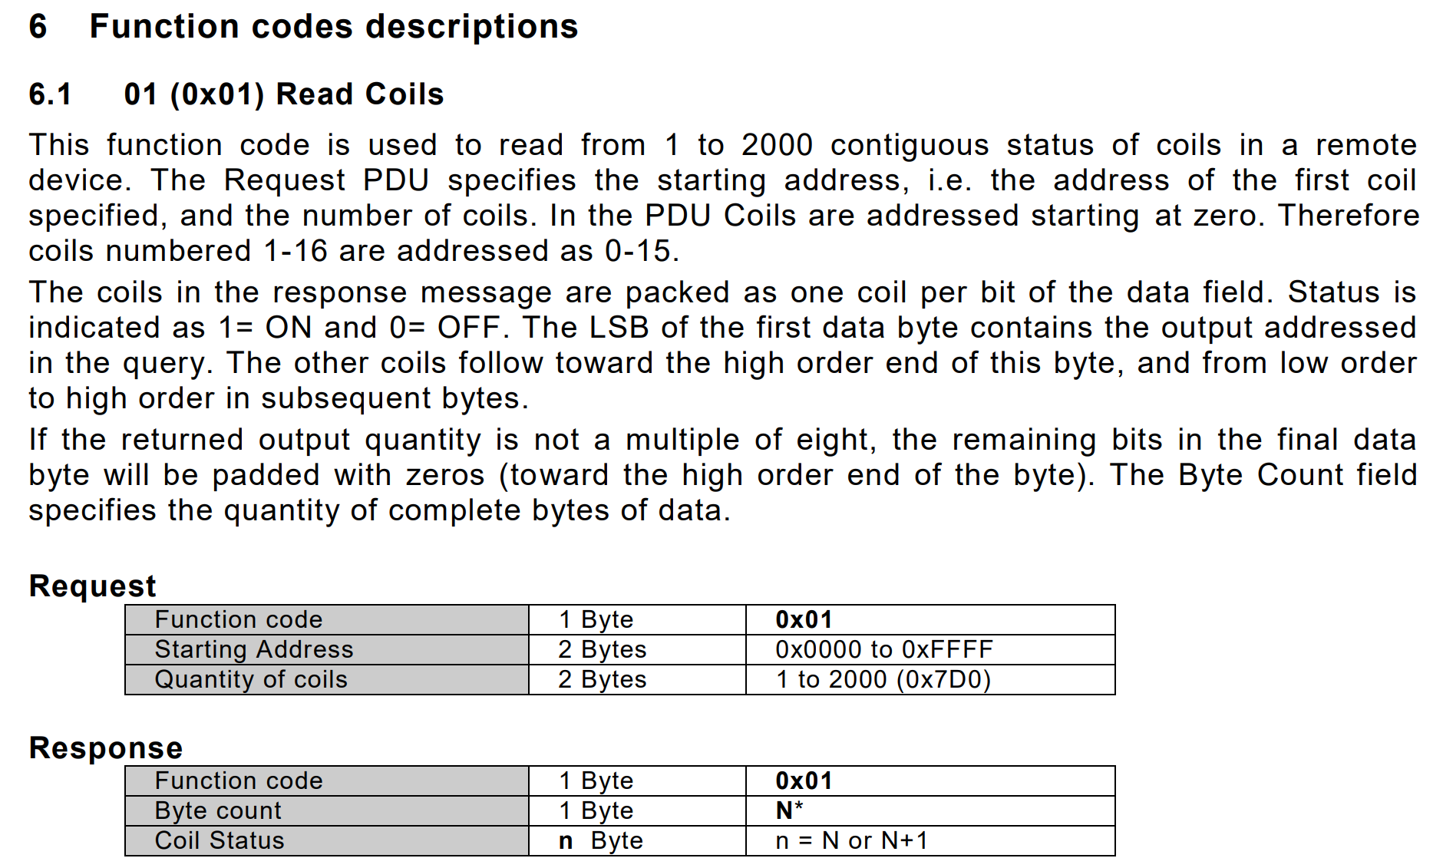
READ COILS

Slide 21
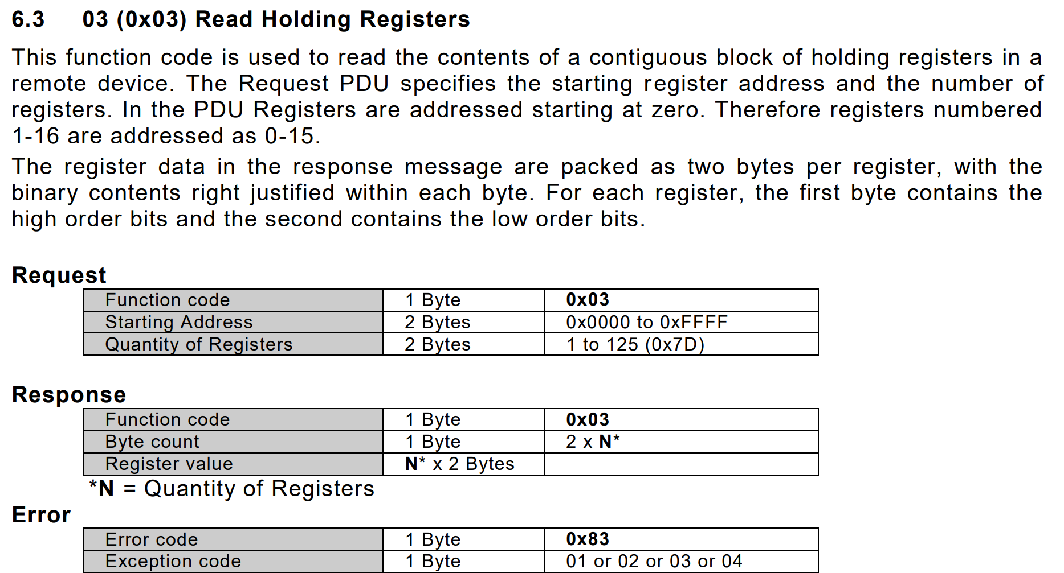
READ Holding Registers

Slide 22
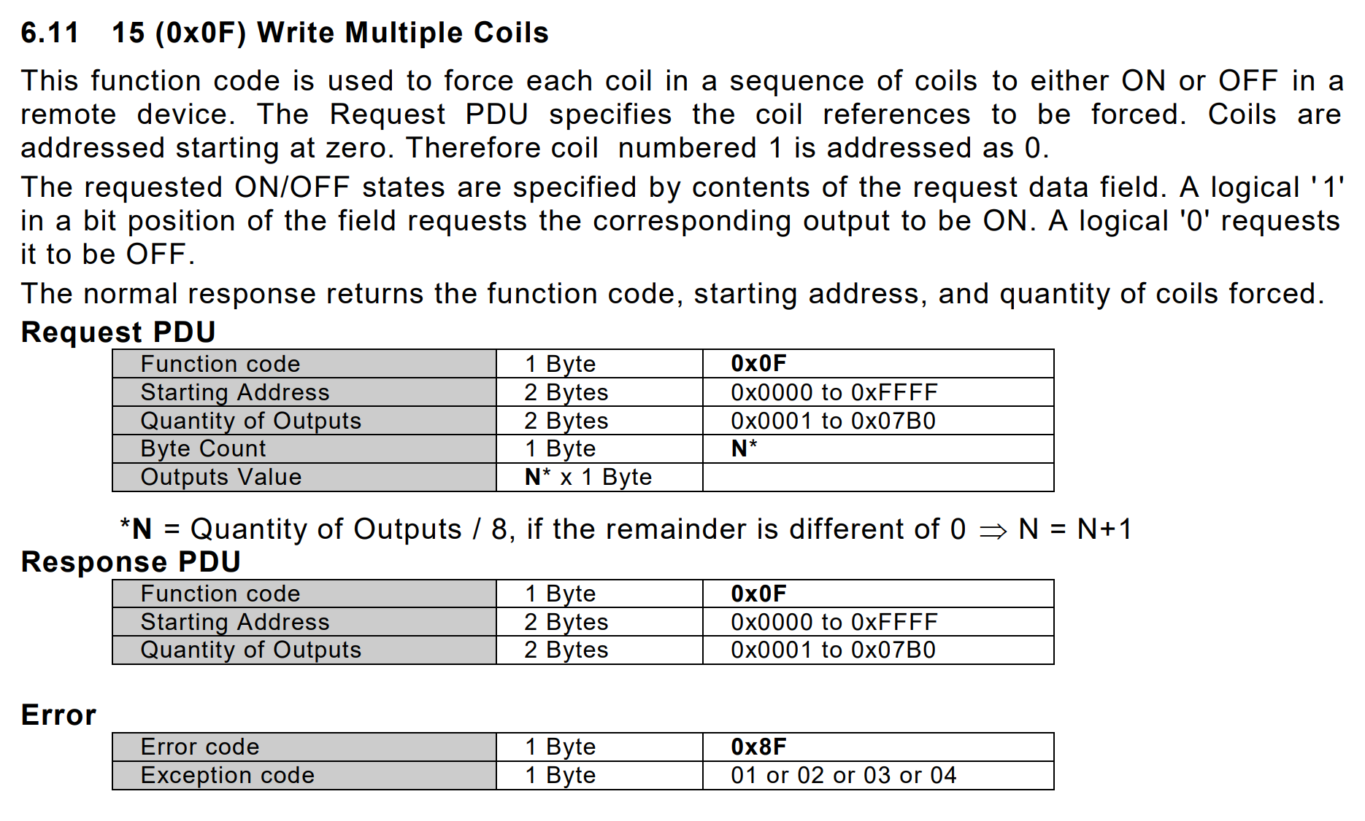
Write Multiple Coils

Slide 23
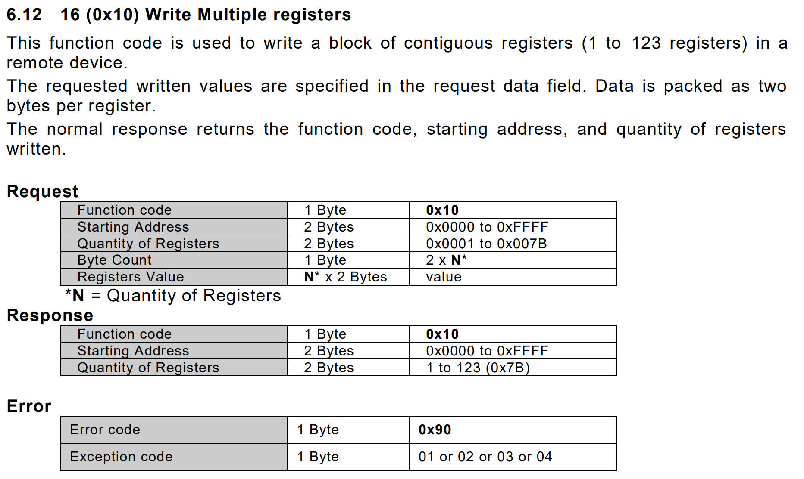
Write Multiple Registers

Slide 24
Exercise WireShark
Install Wireshark
While running your advanced HMI and ladder logic blocks start wireshark and observe traffic from the “Virtual Host Only Network” interface.
What is the IP address of the client?
What is the IP address of the server?
Which ip address has port 502 as the source?
Which ip address has ephemeral port number as the source?
Which ip address sends requests?
Which ip address sends responses?

Slide 25
Exercise WireSHARK
Write 7777 to your number1 register from the HMI.
Find a Modbus write packet with that number.
Is there more than one?
Find a Modbus read packet with that number.
Is there more than one?

Slide 26
MODBUS READ VS WRITE
When a value changes in the HMI, that value only needs to be written once.
Modbus continuously polls (reads) registers and coils. This allows the HMI to continuously observe the state of the PLC program and the physical system.

Slide 27
Exercise WireSHARK
Use the Wireshark filters
ipv4.src == (client IP) &&
Modbus.func_code == Write Single Register
The function codes are here:
http://www.modbus.org/docs/Modbus_Application_Protocol_V1_1b3.pdf

Slide 28
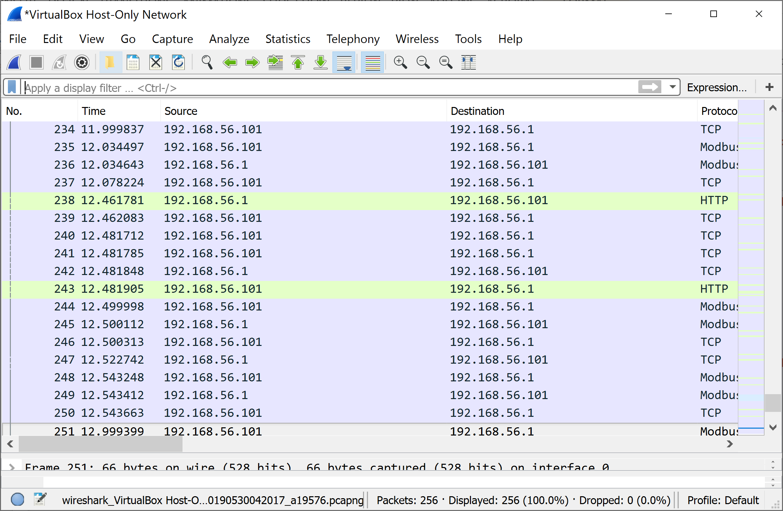
exercise WireShark
How many READS of any type are in your PCAP file?
Hint use a filter to display only reads from the client.
Filter for all read function codes.
When the filter is correct, the number of read packets will be “Displayed” on the bottom of the window. When correct, this number will be less than the “Packets” value immediately to the left.

Slide 29
No Authentication No Digital Signature
No Authentication
No traceability: No way to log who joins the network
Repudiation (as opposed to non-repudiation)
No Digital Signature with payload
No payload (data) integrity
Data injection attacks (false data)
Command injection (false commands)

